Slide 1
Network Theory: Dynamic Ego Networks

Slide 2
Ego-Networks from Structure to Change
The larger the ego network:
  The more diverse, less homophilous, more open
Smaller ego networks:
  Tend to be more clustered , less diverse
The more diversity
  Less homophily
The higher average tie strength
  The more clustering, less diversity
The more proportion kin
  The more homophily, less diversity, more clustering
b
a
c
h
Ego
d
g
e
f

Slide 3
Ego-Networks from Structure to Change
b
a
b
c
a
c
h
Ego
h
Ego
d
d
g
e
g
e
f
f
What can happen over time?

Slide 4
Ego-Networks from Structure to Change
b
a
b
c
a
c
h
Ego
h
Ego
d
d
g
e
g
e
f
f
What can happen over time? Tie Decay

Slide 5
Ego-Networks from Structure to Change
b
a
b
c
a
c
h
Ego
h
Ego
d
d
g
e
g
e
f
f
What can happen over time? Tie Formation

Slide 6
Ego-Networks from Structure to Change
b
a
b
c
a
c
h
Ego
h
Ego
d
d
g
e
g
e
f
f
What can happen over time? Tie Formation among alters

Slide 7
Ego-Networks from Structure to Change
b
a
b
c
a
c
h
Ego
h
Ego
d
d
g
e
g
e
f
f
What can happen over time? Tie decay among alters

Slide 8
Ego-Networks from Structure to Change
b
a
b
c
a
c
h
Ego
h
Ego
d
d
g
e
g
e
f
f
What can happen over time? Tie regeneration

Slide 9
Ego-Networks from Structure to Change
b
a
c
c
h
Ego
Ego
d
d
g
e
g
e
f
f
What can happen over time? Turnover

Slide 10
Ego-Networks from Structure to Change
b
a
o
c
n
c
h
Ego
m
Ego
d
d
g
e
g
e
f
f
What can happen over time? Connection to new alters

Slide 11
Ego-Networks from Structure to Change
b
a
o
c
n
c
h
Ego
m
Ego
d
d
g
e
g
e
f
f
What can happen over time? All at the same time!

Slide 12
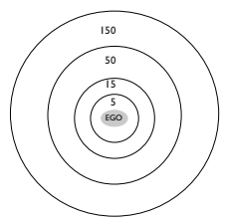
Principles of ego-network evolution
Things to consider:
  Overall ego-networks are subject to relatively high degrees of instability:
    E.g. 55-75% turnover over different measurement occasions
  Tie decay is normal not aberrant
  Different “regions” of the ego network may be subject to different principles
    Stability in the core network
    Instability in the peripheral network
Dunbar diagram

Slide 13
Principles of ego-network evolution
Things to consider:
  Stability of structural properties of ego-networks (e.g. size, density) tend to be stable
    Even if who shows up in the network is not
  Structural properties of ego-networks may thus be ego-signatures
    Preference for large(small) networks
    Preference for closure(brokerage)
    Preference for homophily(heterophily)
    Preference for kin(non-kin) ties
Dunbar diagram

Slide 14
Principles of ego-network evolution
Things to consider:
  Following a given ego over-time may lead us to discover ties in both the core and peripheral network
    Core ties will be contacted first and most often
    Peripheral ties will be contacted later and less often
    Adding the cumulative number of contacts over time give us a sense of the overall size of the individual's total network
Dunbar diagram

Slide 15
Principles of ego-network evolution
Things to consider:
  Following a given ego over-time may lead us to discover ties in both the core and peripheral network
    Core ties will be contacted first and most often
    Peripheral ties will be contacted later and less often
    Core and peripheral status overlap strong with role-relations
      Friends and kin
      Acquaintances, classmates, co-workers
Dunbar diagram

Slide 16
Principles of ego-network evolution
Things to consider:
  Ego-networks change as a response to exogenous shocks experienced by people over time
    Most important are life-course transitions
      Geographical relocation
      Career changes
      School transitions
      Marriage
      Parenthood
      Widowhood
Dunbar diagram

Slide 17
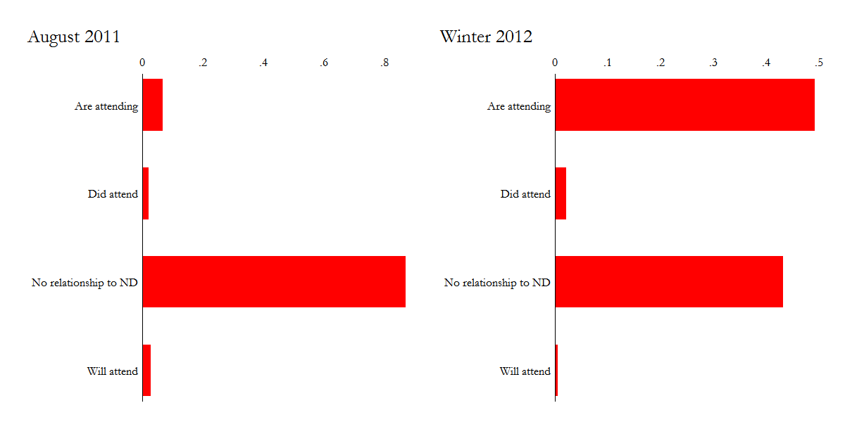
Network relations at two time points in NetSense

Slide 18
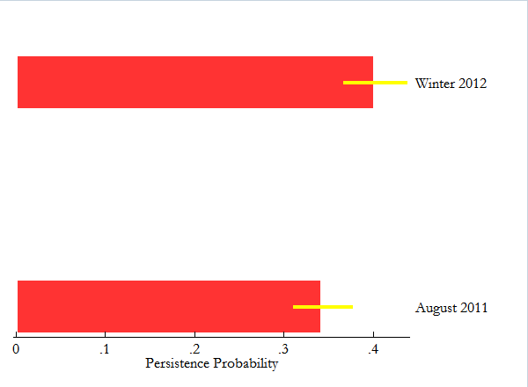
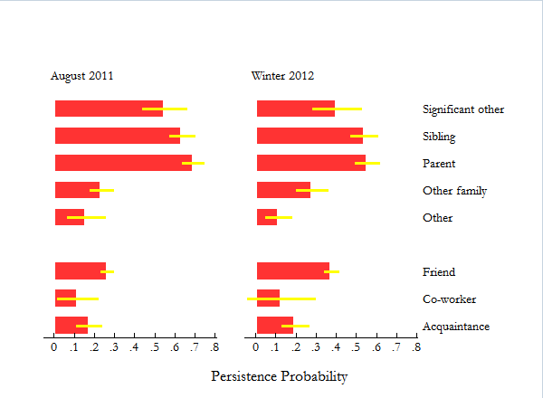
Tie persistence over time in NetSense

Slide 19
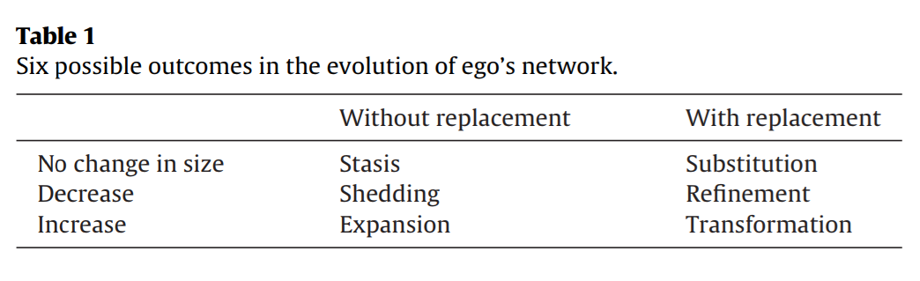

Slide 21
Principles of tie decay
If an individual enters a new context and forms a new tie:
  What are the odds we will observe the tie in the future?
If the ties an individual has are observed at a given time:
  What are the odds that they will be observed again in the future?
Ties have a lifespan
  They are born, they live and then they “die”
Tie decay processes govern the rate or “speed” at which ties disappear from ego networks

Slide 22
Principles of tie decay
1
.5
Liability of newness
The fundamental principle of tie decay is the liability of newness
  The more recently “born” the tie is the more likely it is that it will not be observed in the future
Probability of that the tie will be gone at next time step
1 2 3 4 5 6 7 8
Time

Slide 23
Principles of tie decay
1
.5
Simmelian Dyads
The liability of newness is conditioned by a variety of factors
  Most important: Simmelian dyad status
Probability of that the tie will be gone at next time step
“Standalone” Dyads
1 2 3 4 5 6 7 8
Time

Slide 24
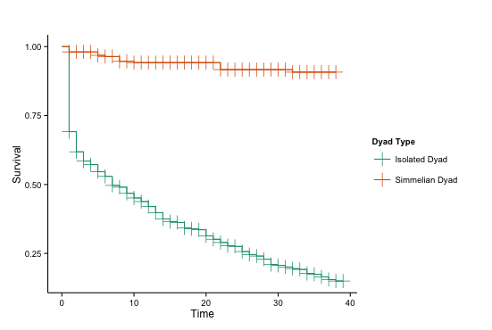
Principles of tie decay
The liability of newness is conditioned by a variety of factors
  Most important: Simmelian dyad status

Slide 25
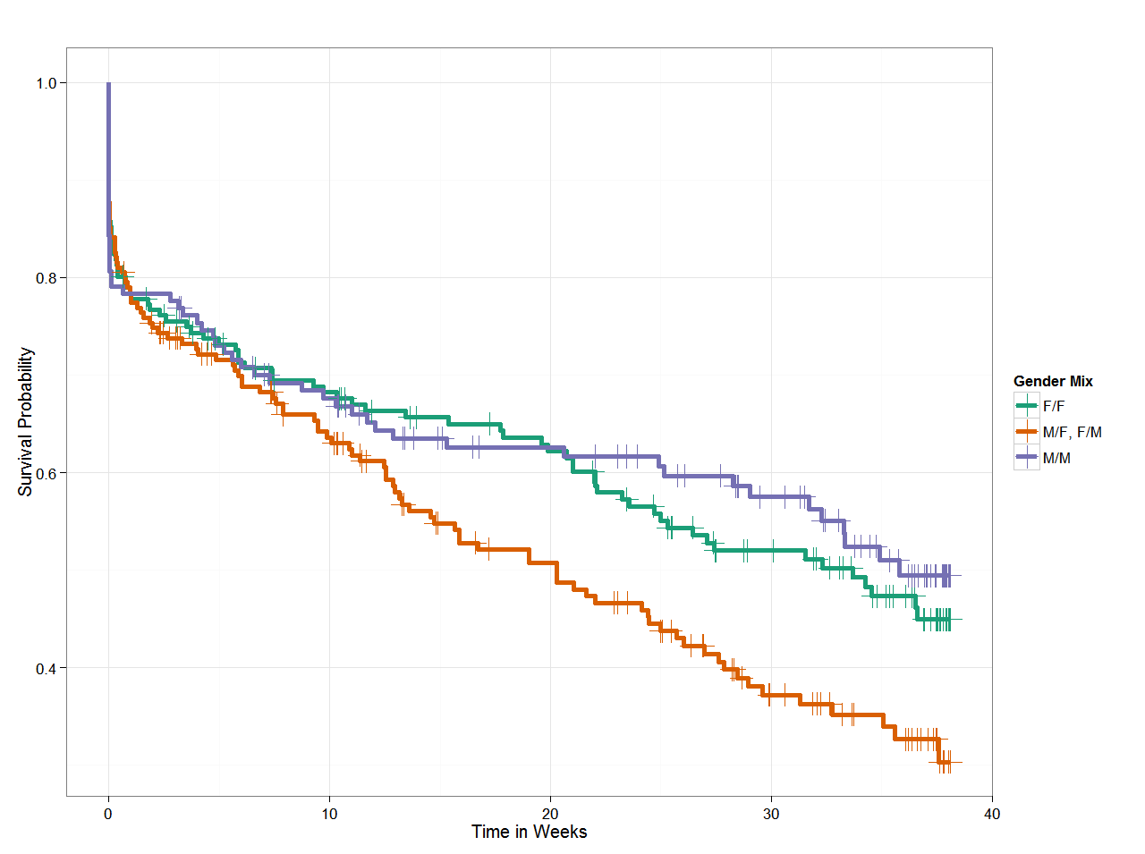
Principles of tie decay
The liability of newness is conditioned by a variety of factors
  Most important: Simmelian dyad status
  Also:
    Node characteristics
    Tie-strength
    Homophily
    Social Foci
  Transitions out Simmelian status bring back the liability of newness

Slide 26
Principles of tie decay
1
.5
Simmelian Dyads
The liability of newness is conditioned by a variety of factors
  Most important: Simmelian dyad status
  Also:
    Node characteristics
    Tie-strength
    Homophily
    Social Foci
  Transitions out Simmelian status bring back the liability of newness
Probability of that the tie will be gone at next time step
“Standalone” Dyads
1 2 3 4 5 6 7 8
Time

Slide 27
What ties are in the ego network?
At any point in time we only observe a subset of an individual’s total “store” of ties
  Different methods will capture different segments of this subset
Thinking about this question dynamically leads to the following typology of ties:
  Active ties
    Currently observed and currently available to ego
  “Dormant” ties
    Currently unobserved and currently available to ego
  Decayed ties
    Previously observed and currently unavailable to ego
      “Real” ego network size = (Active + Dormant) - Decayed

Slide 28
What ties are in the ego network?
At any point in time we only observe a subset of an individual’s total “store” of ties
  Different methods will capture different segments of this subset
Thinking about this question dynamically leads to the following typology of ties:
  If we have information in three time slices then we can differentiate between
    Persistent ties
    Newly formed ties
    Decayed ties
    Short lived ties
    Intermittent ties

Slide 29






Weeks 1 through 13
Weeks 14 through 35
Weeks 36 through 75
Decayed
Newly Formed
Persistent
Short Lived
Intermittent

Slide 30
Weeks 1 through 13
Weeks 14 through 35
Weeks 36 through 75
Decayed
Newly Formed
Persistent
Short Lived
Intermittent

